Slide 1

Experiential Learning Phase - II :
Advanced Algorithms (CS355TBB)
Neurosymbolic AI in Healthcare for Low Grade Glioma Segmentation and Analysis
Aditya Verma
1RV22CS011
Akshatha A
1RV22CS017
Arya Hariharan
1RV22CS029
Gagana M V
1RV22CS054

Slide 2
Implemented Outcomes in Phase - 2
Neural Component
Accurate segmentation masks for LGG regions from MRI images.
Symbolic Component
Interpretability in segmentation results using encoded clinical rules.
Integrated Outcome - Outputs like
"Tumour detected in left frontal lobe with low likelihood of progression."
"Segmentation validated with clinical knowledge, suggesting further biopsy."
Notes:
arya

Slide 3
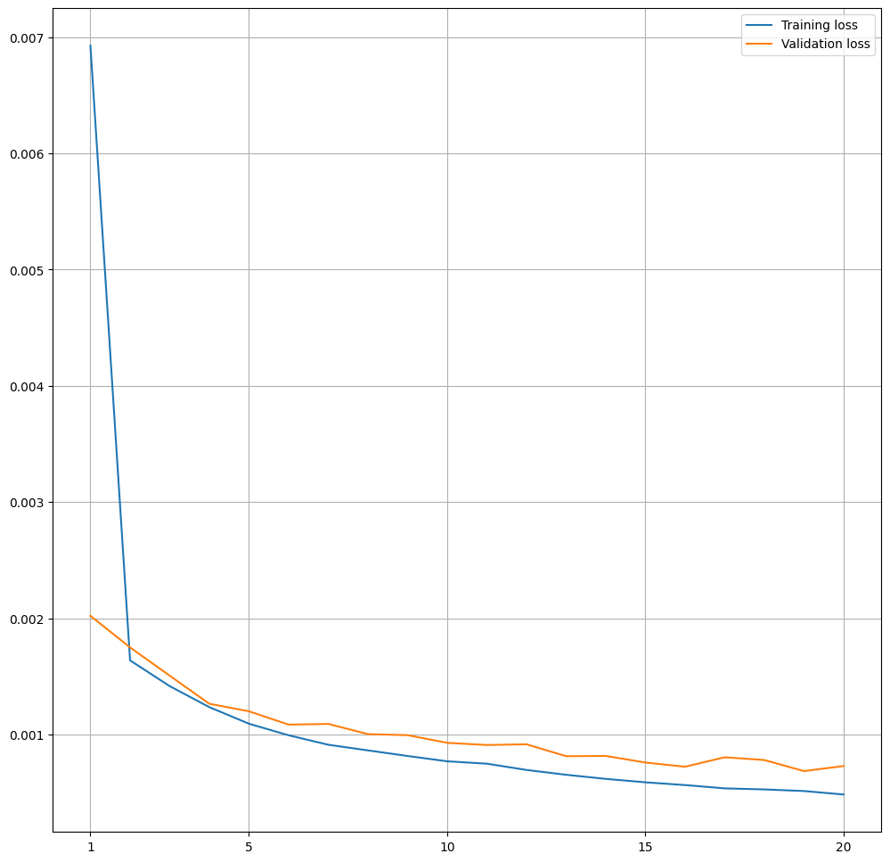
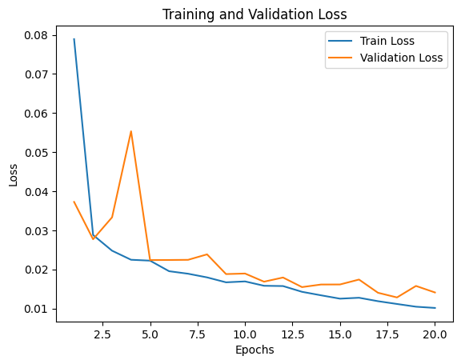
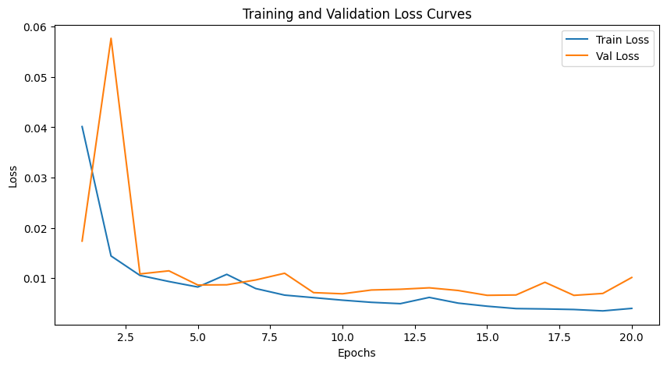
Neural Network Testing Phase
Tested three architectures, namely Vanilla U-Net, FPN and Vanilla U-net. The third outperformed the other two when trained with 70%, 3% and 27% data splits over 20 epochs.
Vanilla U-Net
Testing Loss : 0.010
FPN
Testing Loss : 0.014
U-Net with ResNeXt-50 backbone
Testing Loss : 0.011
Notes:
arya

Slide 4
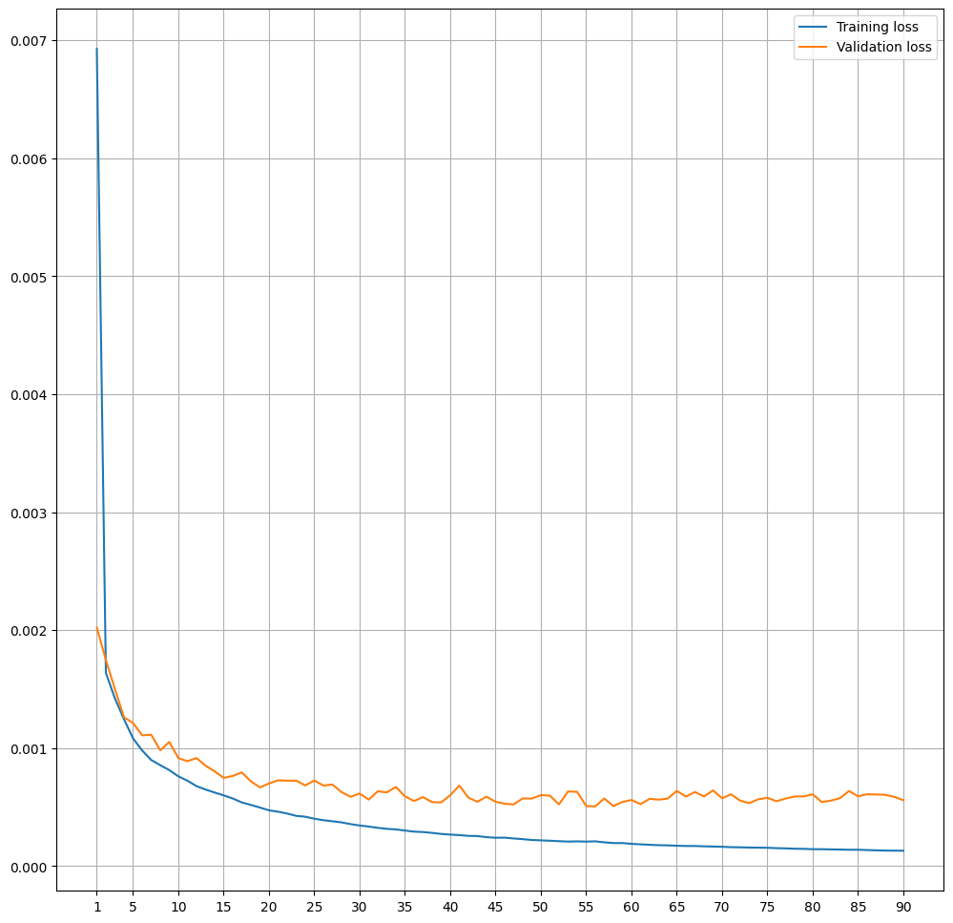
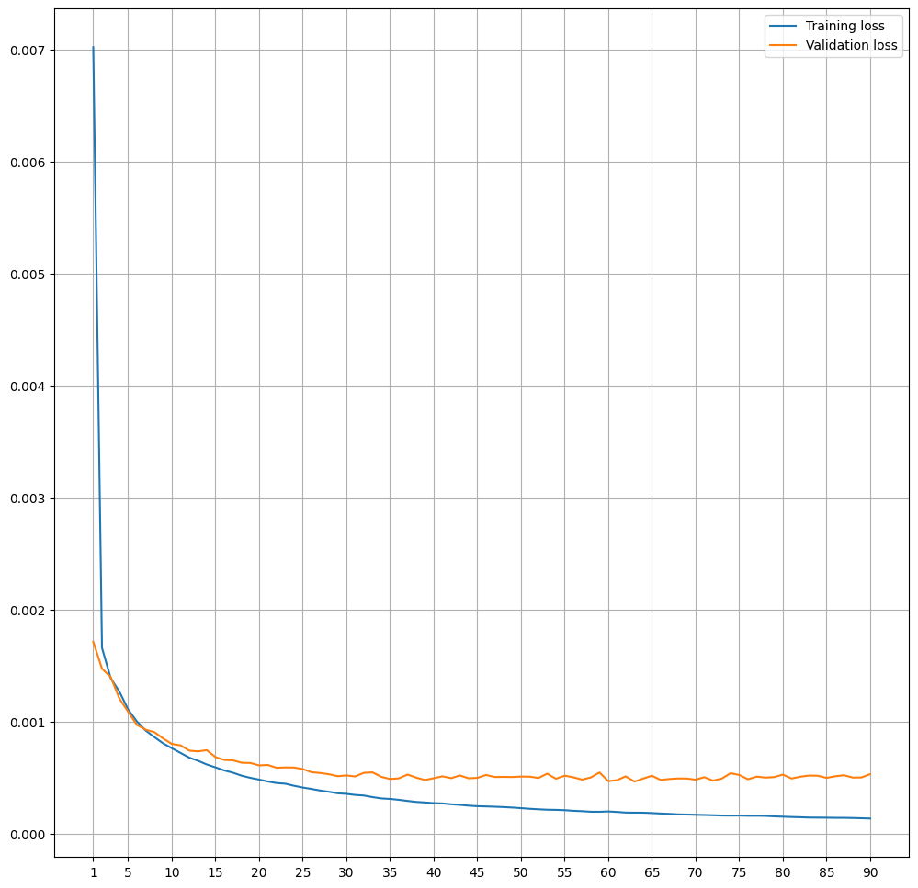
Neural Network Testing Phase
The selected model was then tested on different training, testing and validation splits and with an extended training cycle (90 epochs). The split 70%, 15% and 15% displayed superior performance. This was used for inferencing.
70%, 3% and 27%
Testing Loss : 0.009
70%, 15% and 15%
Testing Loss : 0.008
Notes:
arya

Slide 5
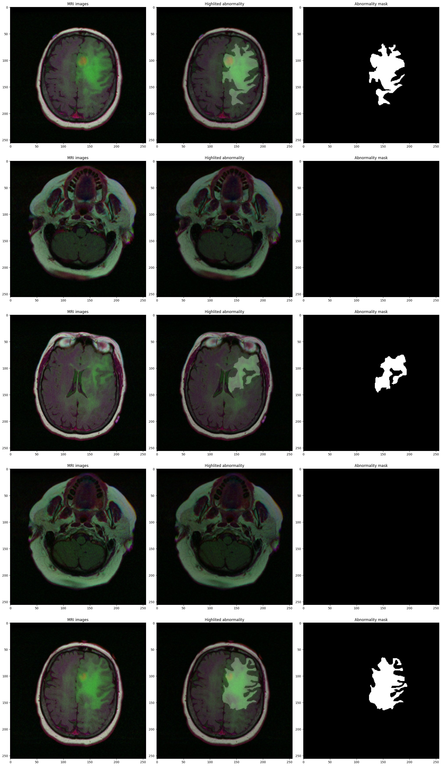
Neural Network
Utilised the U-Net neural network framework with ResNeXt-50 backbone (most commonly used for segmentation tasks) to build the segmentation model, using PyTorch. Model is saved and loaded each time for inference.
Notes:
arya

Slide 6
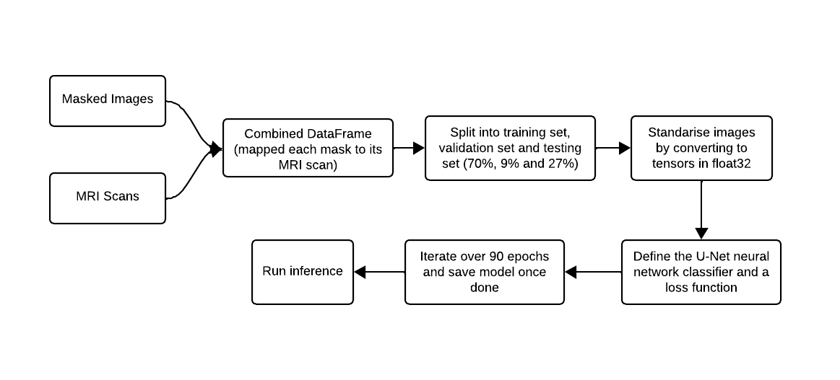
Neural Network Workflow
Notes:
arya

Slide 7
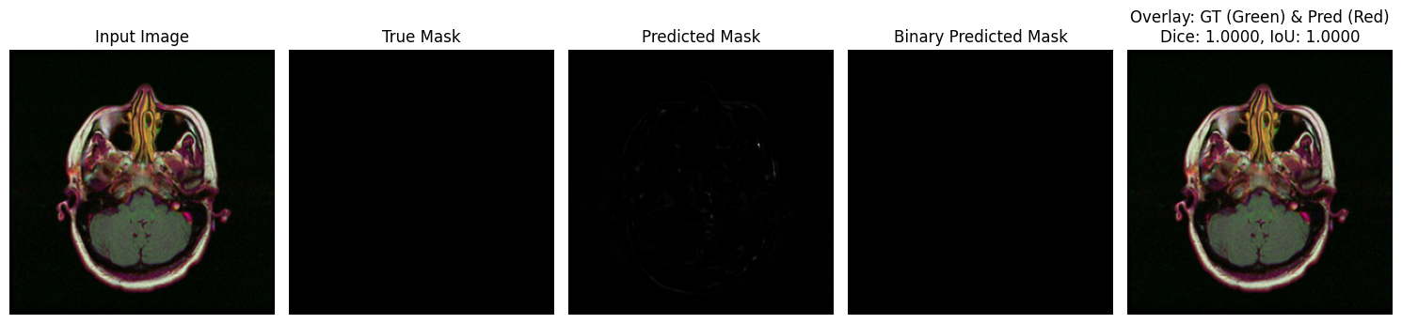
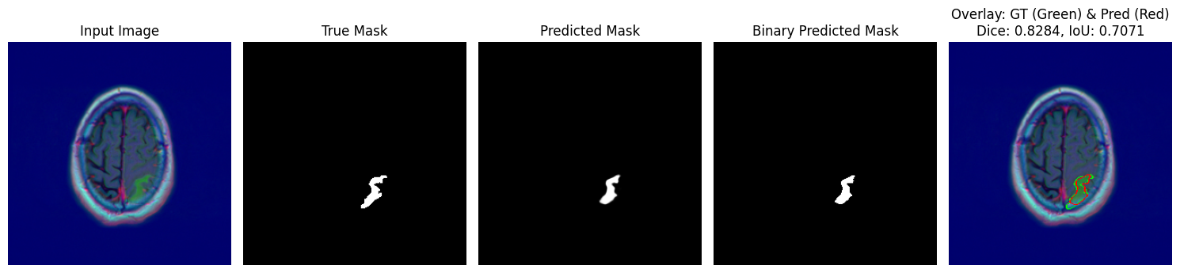
Neural Network Testing Set Output
Notes:
arya

Slide 8
Knowledge graph
A Knowledge Graph (KG) is a structured way to represent relationships between real-world entities. In medical AI, it connects MRI scan data, tumour classifications, medical guidelines, and treatments to enhance decision-making.
WORKFLOW
Extract tumor size & location from MRI scans
Match tumor characteristics with symptoms & mutations
Suggest treatment based on verified medical sources
Predict expected outcomes based on past data
Notes:
arya

Slide 9
Knowledge graph
How We Represent Medical Knowledge?
Nodes (Entities): Tumours, Symptoms, Mutations, Treatments.
Edges (Relationships): Links between entities (e.g., "Tumour requires Surgery").
Graph-Based AI Interpretation: Helps doctors understand AI decisions.
How Does the Graph Work?
AI Segments MRI Tumours → Extracts tumour size, location
Nodes & Relationships Created → Tumour linked to risks, treatments, mutations
Graph is Visualized → Doctors see connections between symptoms & treatments.
Notes:
arya

Slide 10
Knowledge graph
How Tumours Are Classified?
✔ Size-based classification:
Small Tumour: < 20 mm
Medium Tumour: 20 - 40 mm
Large Tumour: > 40 mm
✔ Mutation-based classification:
IDH Mutation → Targeted Therapy
MGMT Methylation → Chemotherapy
✔ Symptoms & Location Analysis:
Tumours in the Frontal Lobe → Cognitive Impairment
Tumours in the Parietal Lobe → Seizures
Notes:
arya

Slide 11
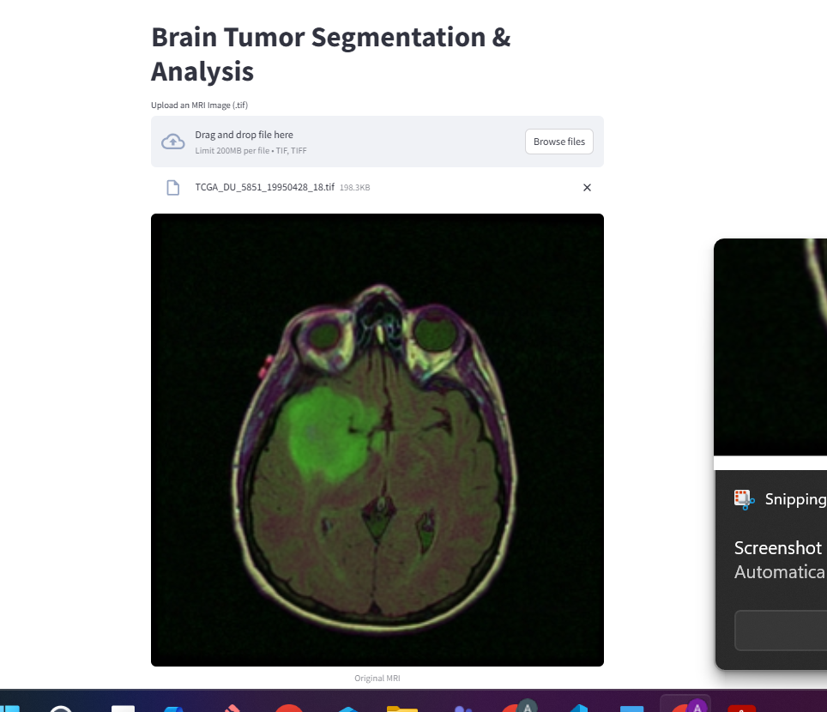
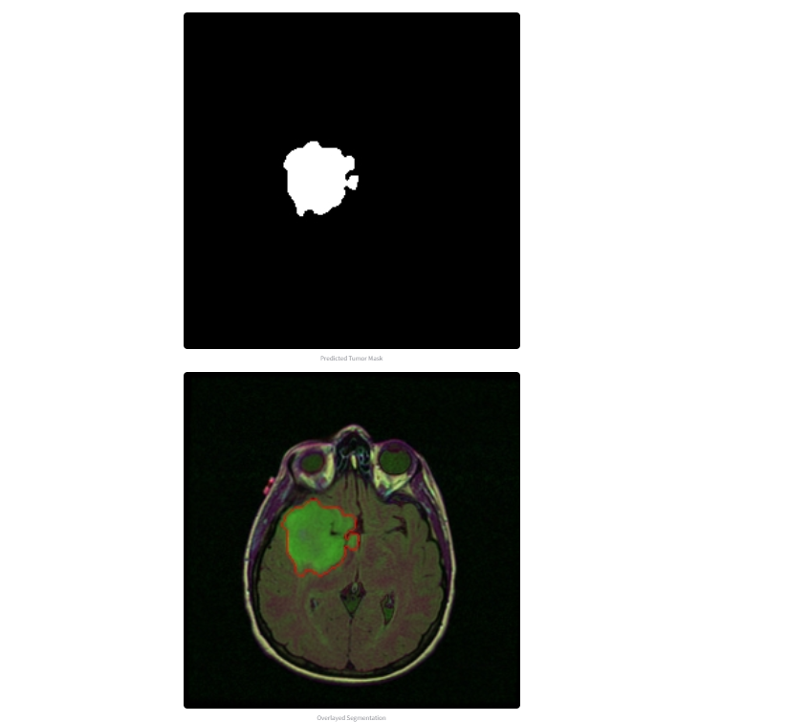
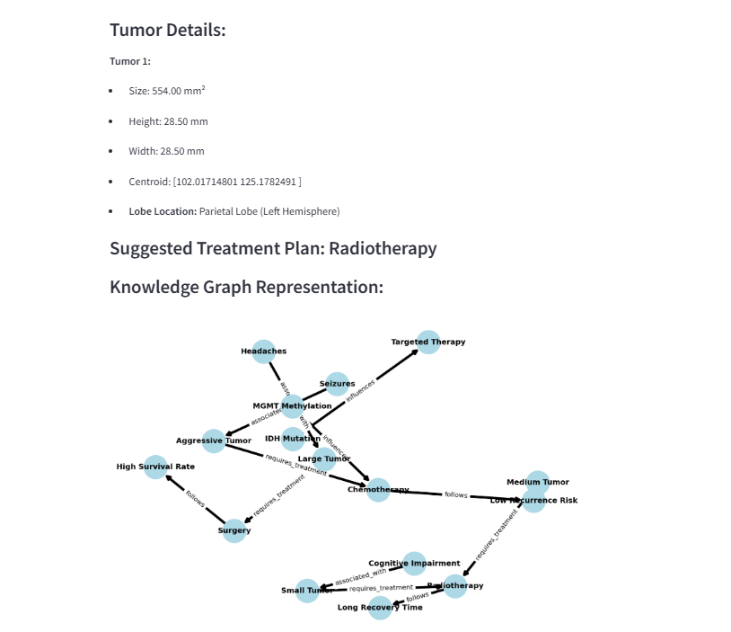
Web Interface
User can enter MRI Scan and view it
User can view the binary prediction and overlay
Inference is made using the knowledge graph
Notes:
arya

Slide 12
Thank You
Notes:
arya

